Slide 1
Visualisation for Data Analytics: More Plots

Slide 2
Learning Outcome
To learn some more charts for data visualisation

Slide 3
Outline
Bubble charts
Heat Maps
Radar Charts
Area Charts
Folium Library
Maps

Slide 4
Bubble Chart

Slide 5
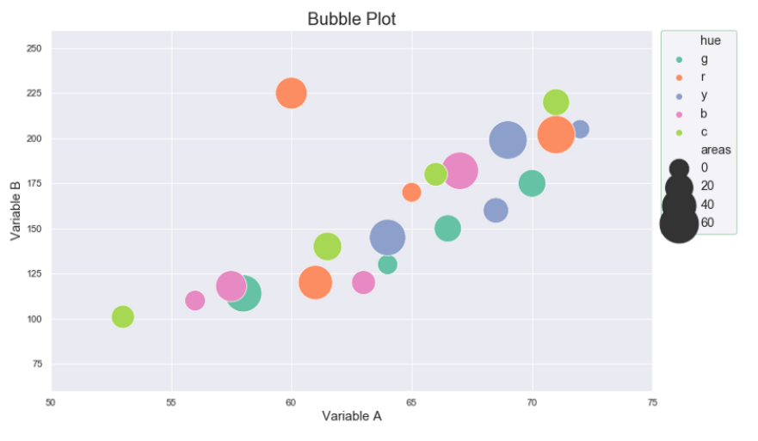
Bubble Charts
Bubble charts are used to determine if at least three numerical variables are related or share some kind of pattern.
Under special circumstances, they could be used to show trends over time or to compare categorical variables.
They are considered a natural extension of the scatter plot where the dots are replaced with bubbles or disks.
https://towardsdatascience.com/bubble-charts-why-how-f96d2c86d167#:~:text=Why%3A%20bubble%20charts%20are%20used,or%20to%20compare%20categorical%20variables.

Slide 6
Bubble Charts
A bubble or disk is drawn for each observation of a pair of numerical variables (A, B) positioning, in a Cartesian coordinate system, the disk horizontally according to the value of variable A and vertically according to variable B.
A third numerical variable C is represented by means of the area of the bubble.
You can even incorporate a fourth dataset (D: numerical or categorical) using different colors in different bubbles.

Slide 7
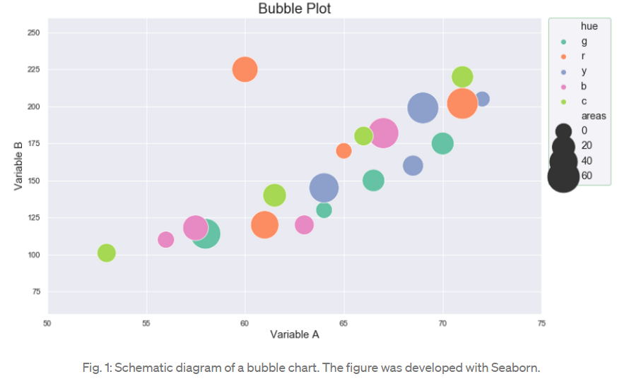
Bubble Charts
The story is narrated from the shape that these data points generate as well as from the differences in the relative sizes of the bubbles or discs.
There must be appropriate legends for the dissimilar categories represented by the colors and some type of scale that allows us to infer the numerical value indicated by the size of the bubble.

Slide 8
Question?(m)
What are your observations using this bubble chart?
https://towardsdatascience.com/bubble-charts-why-how-f96d2c86d167#:~:text=Why%3A%20bubble%20charts%20are%20used,or%20to%20compare%20categorical%20variables.

Slide 9
Observations
Positive relation between A and B
The orange bubble on top is outlier
No pattern observed w.r.t. size or colour
https://towardsdatascience.com/bubble-charts-why-how-f96d2c86d167#:~:text=Why%3A%20bubble%20charts%20are%20used,or%20to%20compare%20categorical%20variables.

Slide 10
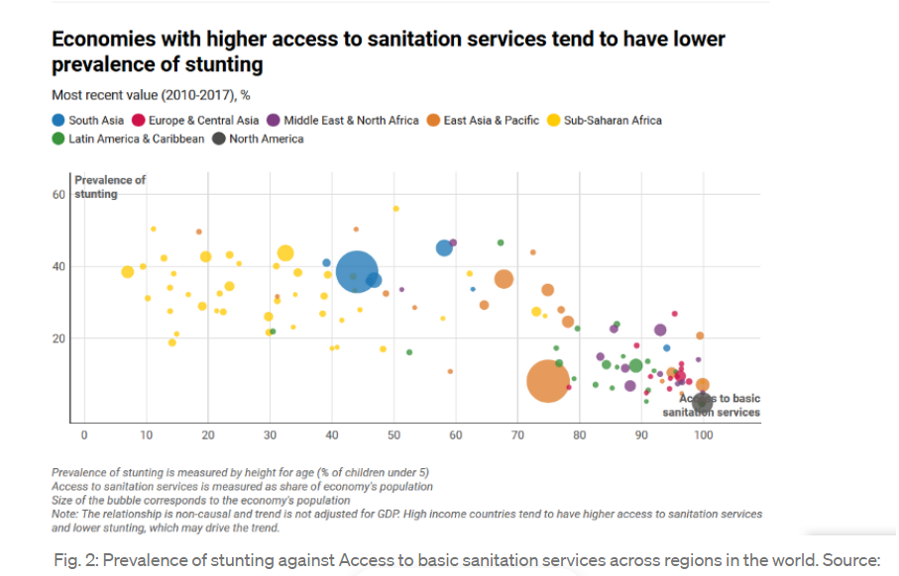
Bubble chart describes the Prevalence of stunting against Access to basic sanitation services across regions in the world
https://towardsdatascience.com/bubble-charts-why-how-f96d2c86d167#:~:text=Why%3A%20bubble%20charts%20are%20used,or%20to%20compare%20categorical%20variables.

Slide 11
Prevalence of stunting against Access to basic sanitation services
Research shows that poor sanitation contributes to childhood stunting and that the brains of stunted children have fewer neuronal connections than children who are not stunted.
As technology is replacing routine jobs, demand is rising for advanced cognitive skills and greater adaptability, even in developing countries.
But, stunted children will be at a disadvantage concerning the skills demanded by the future labor market.
The prevalence of yellow bubbles in the upper left of the chart indicates that the Sub-Saharan Africa region makes up a clear cluster of countries where millions of children are growing up without future basic life skills. As the size of the disks corresponds to the region’s population, the chart also shows the urgent need to bring safe sanitation to millions of children in South Asia
https://towardsdatascience.com/bubble-charts-why-how-f96d2c86d167#:~:text=Why%3A%20bubble%20charts%20are%20used,or%20to%20compare%20categorical%20variables.

Slide 12
Ted Talk
Watch the following video to find more example
The best stats you've ever seen
The River of Myths” of 2013 (#4).

Slide 13
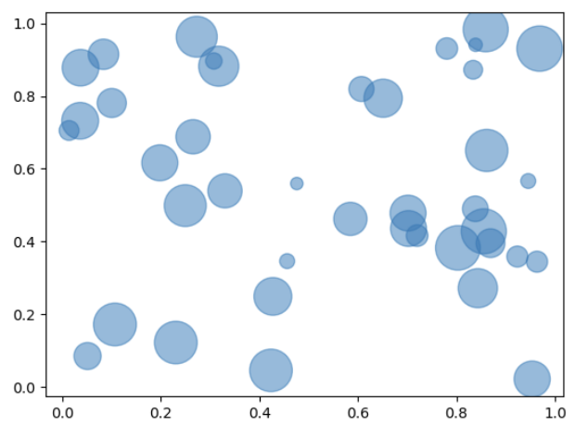
Creating bubble charts in python
import matplotlib.pyplot as plt
import numpy as np
# create data
x = np.random.rand(40)
y = np.random.rand(40)
z = np.random.rand(40)
# use the scatter function
plt.scatter(x, y, s=z*1000)
# show the graph
plt.show()

Slide 14
Heat map

Slide 15
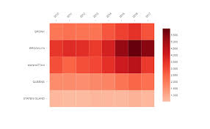
Heat map
A heat map (or heatmap) is a graphical representation of data where values are depicted by color.
Heat maps make it easy to visualize complex data and understand it at a glance:
Image source: https://www.google.com/url?sa=i&url=https%3A%2F%2Fwww.displayr.com%2Fhow-to-create-a-heatmap-in-displayr%2F&psig=AOvVaw16ZQBLK4Xw1sc351AnNzWj&ust=1611609483699000&source=images&cd=vfe&ved=0CAIQjRxqFwoTCOjy9ai_te4CFQAAAAAdAAAAABAO
https://www.hotjar.com/heatmaps/#:~:text=A%20heat%20map%20(or%20heatmap,IS%20MUCH%20EASIER%20TO%20UNDERSTAND

Slide 16
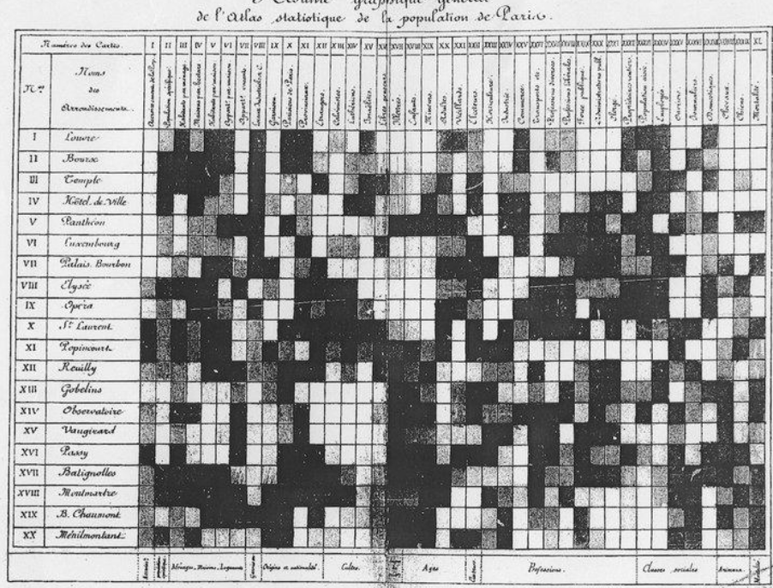
Heat map
The practice we now call heatmaps is thought to have originated in the 19th century, where manual gray-scale shading was used to depict data patterns in matrices and table
An early heat map showing population density in 19th Century Paris districts.
https://www.hotjar.com/heatmaps/

Slide 17
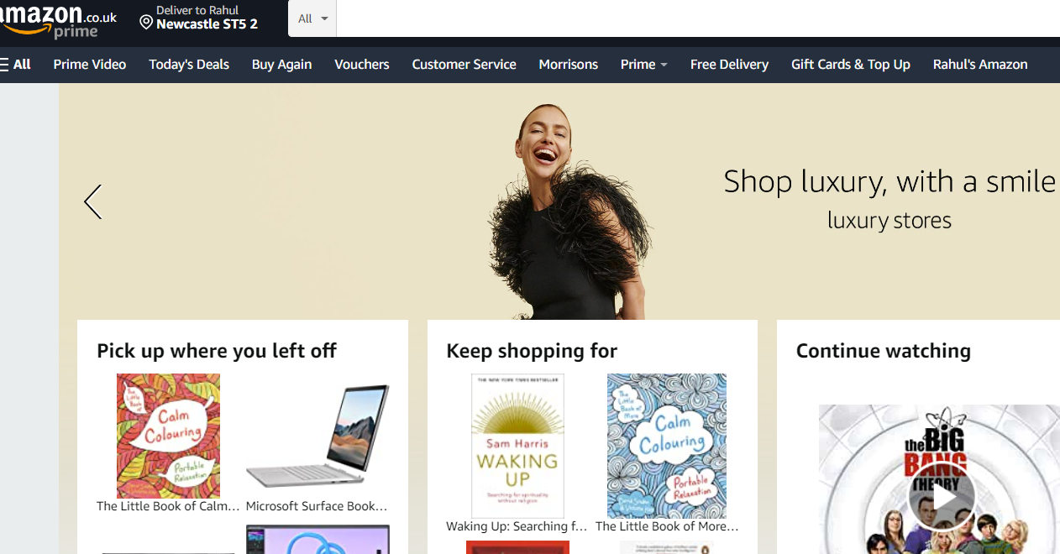
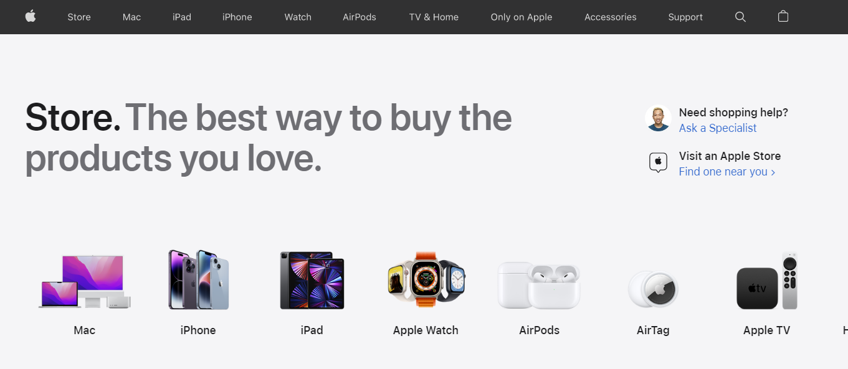
Question?(m)
How companies decide where to put important things on their websites?

Slide 18
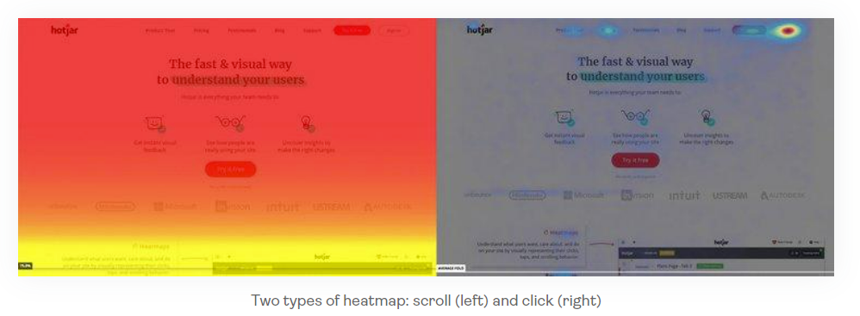
Uses of heat map
Done through user behavior analytics (UBA)
Companies identifies on which icon user click most or interact most
This information is presented in the form of heatmap

Slide 19
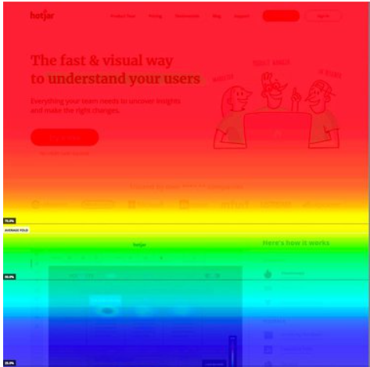
Uses of heat map
Example: Scroll map
It shows which part of the webpage is getting most attention by the users
https://www.hotjar.com/heatmaps/

Slide 20
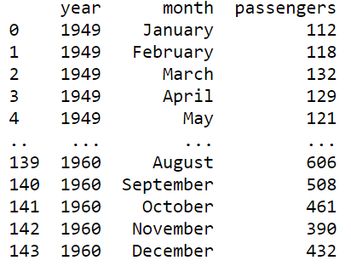
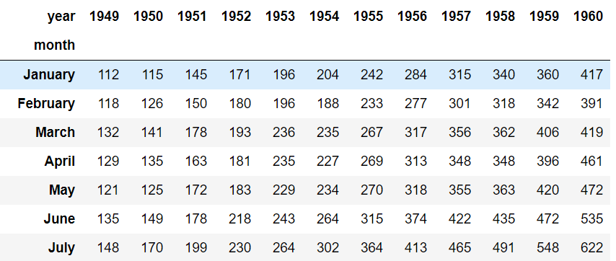
Heat map in Python
Using ‘seaborn’ library
We have flight data like this➔
You can see that it has lots of information
So we will extract the information that is required using ‘Pivot’
Dataframe. pivot("month", "year", "passengers")
By doing this we will a 2D matrix ➔
We can use this 2D matrix for heatmap plotting

Slide 21
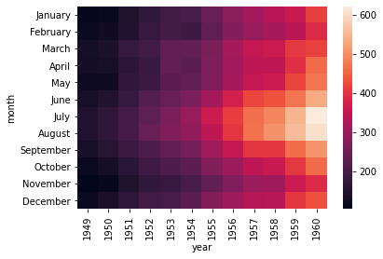
Question?
What analysis you can draw from this heat map?
Most of the people taking flights in June-July
In 1949 there are very less or no flights

Slide 22
Heat map in Python
import matplotlib.pyplot as plt
import seaborn as sns
flights = sns.load_dataset("flights").pivot(
index="month", columns="year", values="passengers")
sns.heatmap(flights)
plt.show()
Any observations?
sns.heatmap(flights, cmap="crest") #try this out
https://seaborn.pydata.org/generated/seaborn.heatmap.html
Using ‘seaborn’ library

Slide 23
Spider or Radar chart

Slide 24
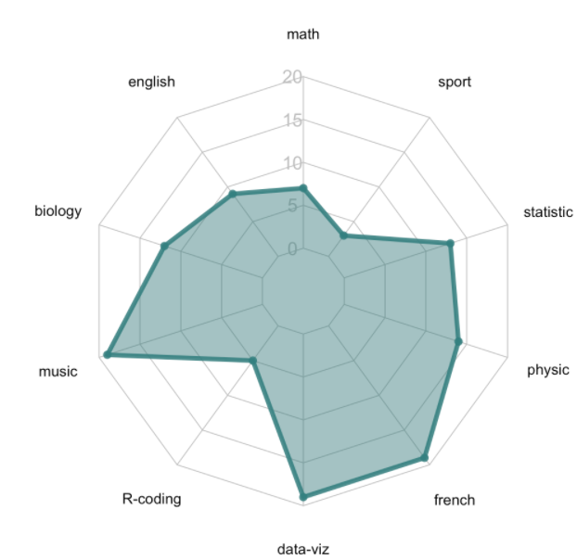
Spider or Radar chart
A radar or spider or web chart is a two-dimensional chart type designed to plot one or more series of values over multiple quantitative variables.
Each variable has its own axis, all axes are joined in the centre of the figure.
Example: Let’s consider the exam results of a student. He has a mark ranging from 0 to 20 for ten topics like math, sports, statistics, and so on.
The radar chart provides one axis for each topic. The shape allows you to see which topics the student performed well or poorly in.
https://www.data-to-viz.com/caveat/spider.html#:~:text=A%20radar%20or%20spider%20or,the%20center%20of%20the%20figure.&text=The%20radar%20chart%20provides%20one%20axis%20for%20each%20topic.

Slide 25
Question?(m)
Share your observations for this radar plot?

Slide 26
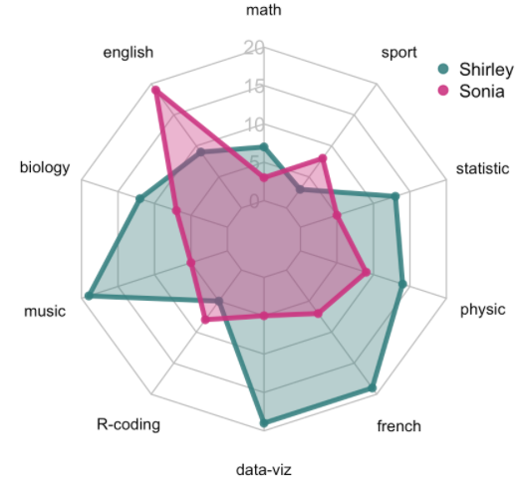
Spider or Radar chart
In the previous chart, only one series is plotted, showing how one student performed.
A common task is to compare several individuals. With only a few series it is possible to show every group on the same chart.
Here it is quite obvious that Shirley globally performed better than Sonia, except in Sport, English and R-coding.
https://www.data-to-viz.com/caveat/spider.html#:~:text=A%20radar%20or%20spider%20or,the%20center%20of%20the%20figure.&text=The%20radar%20chart%20provides%20one%20axis%20for%20each%20topic.

Slide 27
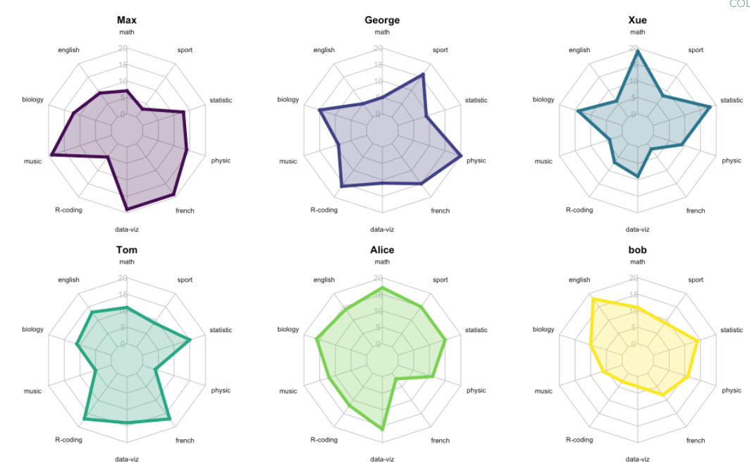
Spider or Radar chart
With more than two or three series, it is a good practice to use small multiples to avoid a cluttered figure.
Each student is represented on their own radar chart. It is easy to understand the features of a specific individual, and looking for similarity in shapes allows you to find students with similar features.
https://www.data-to-viz.com/caveat/spider.html#:~:text=A%20radar%20or%20spider%20or,the%20center%20of%20the%20figure.&text=The%20radar%20chart%20provides%20one%20axis%20for%20each%20topic.

Slide 28
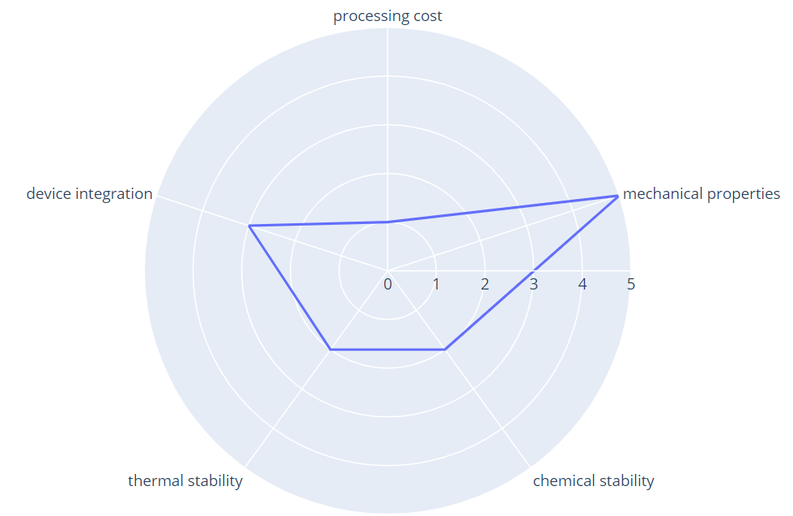
Spider or Radar chart In Python
import plotly.express as px
import pandas as pd
df = pd.DataFrame(dict(
r=[1, 5, 2, 2, 3],
theta=['processing cost','mechanical properties','chemical stability’, 'thermal stability', 'device integration']))
fig = px.line_polar(df, r='r', theta='theta', line_close=True)
fig.show()
fig.update_traces(fill='toself')
fig.update_traces(fill='toself’) #try this out

Slide 29
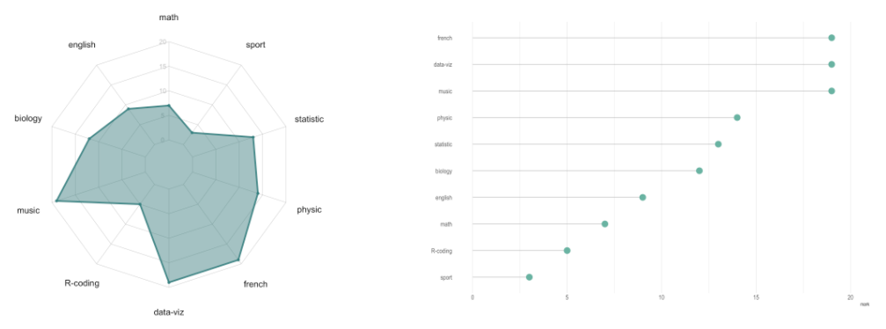
Disadvantages of Spider or Radar chart
Circular layout = harder to read - quantitative values are much easier to compare when they are laid out along a single vertical or horizontal axis. This is a general reproach made to circular layouts. Compare the figure below that considers the data of one student only. It is easier to compare values in the bar chart, and more accurate.
https://www.data-to-viz.com/caveat/spider.html#:~:text=A%20radar%20or%20spider%20or,the%20center%20of%20the%20figure.&text=The%20radar%20chart%20provides%20one%20axis%20for%20each%20topic.

Slide 30
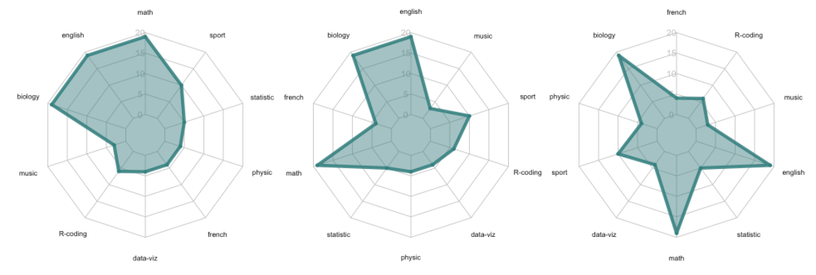
Disadvantages of Spider or Radar chart
Category order has a huge impact - Radar chart readers will probably focus on the shape observed. This can be misleading since this shape highly depends on the ordering of categories around the plot. See these charts made using the same data, but changing the category ordering:
https://www.data-to-viz.com/caveat/spider.html#:~:text=A%20radar%20or%20spider%20or,the%20center%20of%20the%20figure.&text=The%20radar%20chart%20provides%20one%20axis%20for%20each%20topic.

Slide 31
Area Charts

Slide 32
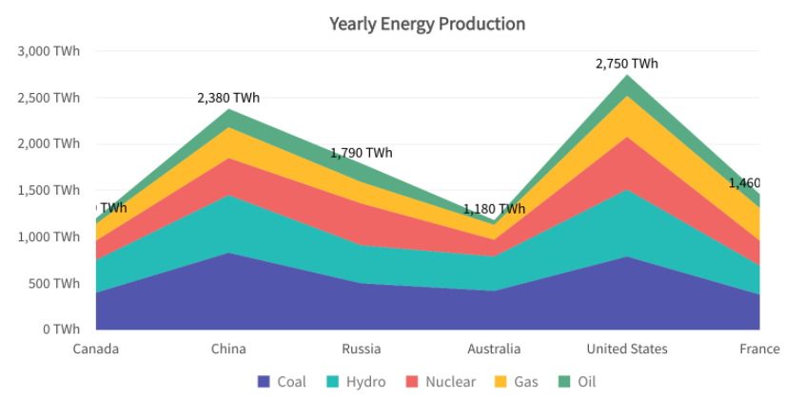
Area Charts
An area chart is like a line chart in terms of how data values are plotted on the chart and connected using line segments. In an area chart, however, the area between the line segments and the x-axis is filled with color.
Area charts are used to compare time series and distribution functions. An area chart is a good choice when you want to see volume change over a period of time, without focusing on specific data values. It gives a sense of summation of the quantitative data.

Slide 33
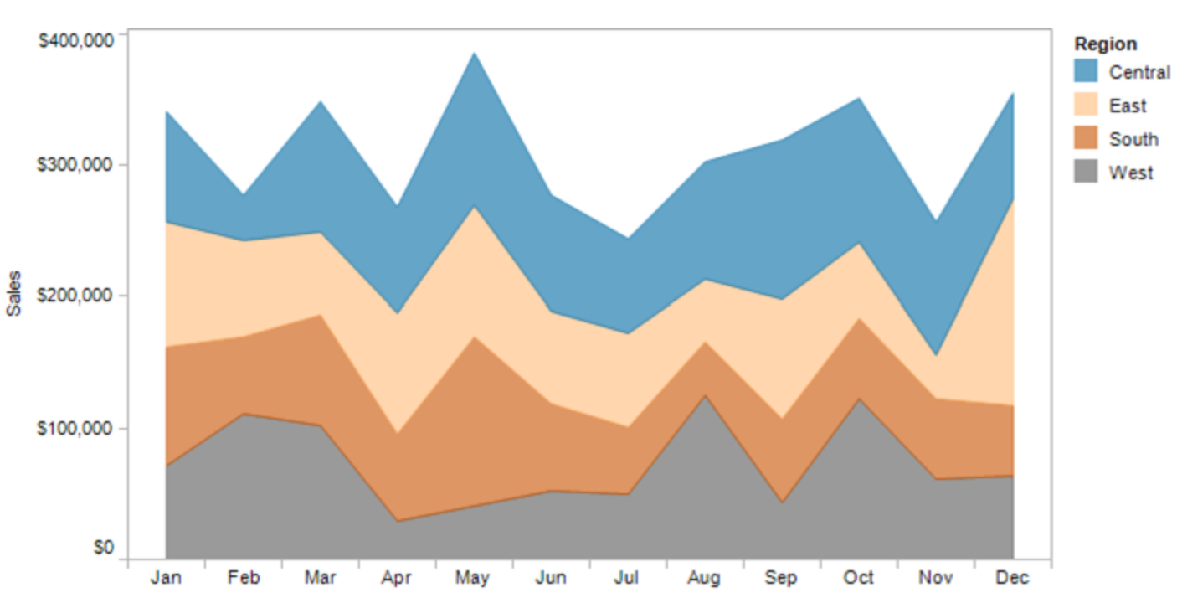
Area Chart
Our eyes tend to focus on the tops of each line, leading to misinterpreting the patterns.
It’s nearly impossible for us to translate the width of each color (i.e., the actual value) into an accurate trend. This is because the pattern of each color is influenced by the colors below it.
The only values that can be effectively interpreted are the West (grey area) and the total (top of the blue line).

Slide 34
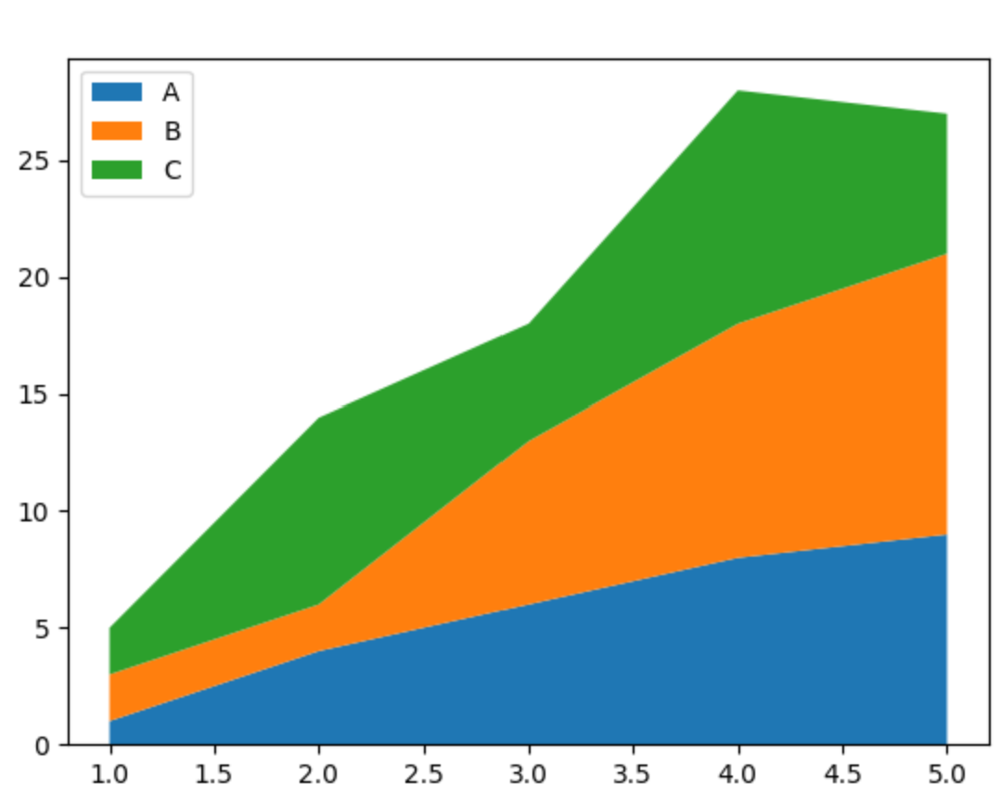
Area Chart
import numpy as np
import matplotlib.pyplot as plt
x=range(1,6)
y=[ [1,4,6,8,9],
[2,2,7,10,12],
[2,8,5,10,6] ]
chart = plt.stackplot(x,y, labels=['A','B','C’])
plt.legend(loc='upper left’)
plt.show()

Slide 35
Maps

Slide 36
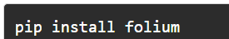
Maps
Maps are the guiding force for us to explore the world, get to our destination every day, and have helped us explore and evolve our understanding of the world.
Folium is a Python library used for visualizing geospatial data.
It is easy to use and yet a powerful library.
Folium is a Python wrapper for Leaflet.js which is a leading open-source JavaScript library for plotting interactive maps.

Slide 37
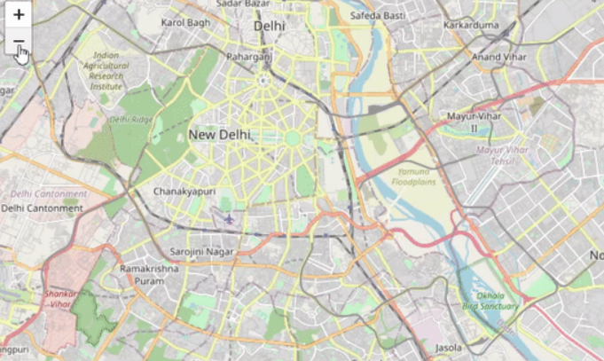
Plotting Maps with Folium
Folium provides the folium.Map() class which takes location parameter in terms of latitude and longitude and generates a map around it.
So, let’s plot a map of Delhi with latitude and longitude as 28.644800 and 77.216721 respectively:
import folium
m=folium.Map(location=[28.644800, 77.216721])
m

Slide 38
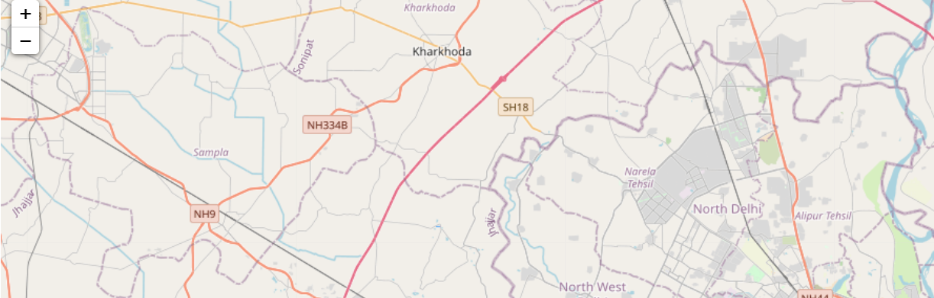
Maps
These maps are interactive. You can zoom in and out by clicking the positive and negative buttons in the top-left corner of the map. You can also drag the map and see different regions

Slide 39
Maps
We can resize our map by using the branca library in Python.
It is a spinoff from Folium that hosts the non-map specific features. We can use its Figure class for resizing our maps and pass the desired width and height in pixels
Notice here that you need to pass the map as a child to the fig object for resizing the map.
from branca.element import Figure
fig=Figure(width=550,height=350)
m1=folium.Map(width=500,height=130,location=[28.644800, 77.216721],zoom_start=11,min_zoom=8,max_zoom=14)
fig.add_child(m1)
You can specify zoom level if you don’t want to allow more zoom in/out

Slide 40
Layers and Tiles in Folium
A tileset is a collection of raster and vector data broken up into a uniform grid of square tiles.
Each tileset has a different way of representing data in the map.
Folium allows us to create maps with different tiles like Stamen Terrain, Stamen Toner, Stamen Water Color, CartoDB Positron, and many more. By default, the tiles are set to OpenStreetMap.
Each tileset shows different features of a map and is suitable for different purposes. For example, Stamen Terrain features hill shading and natural vegetation colors. It showcases advanced labeling and linework generalization of dual-carriageway roads. And, CartoDB Dark Matter shows the CartoDB Positron map in dark mode.

Slide 41
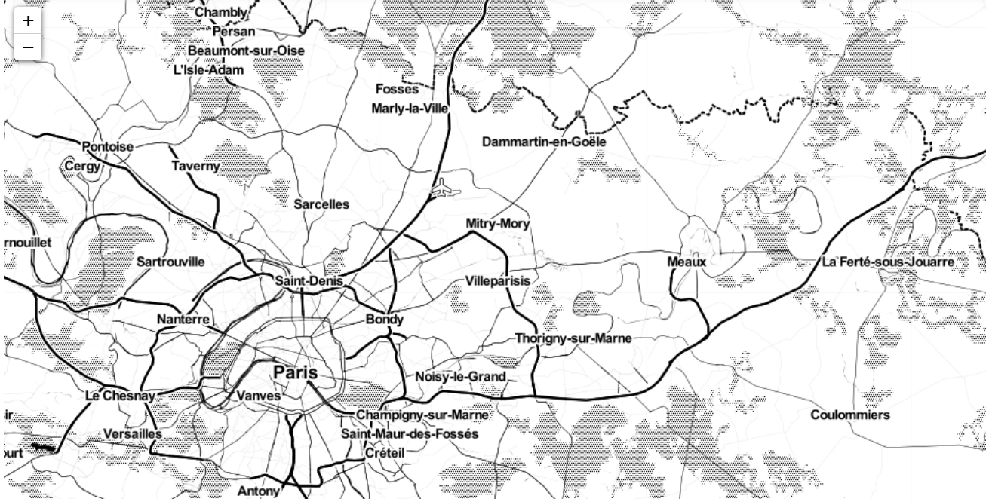
Layers and Tiles in Folium
Lets visit paris with ‘Stamen Toner’ tiles
onerMap = folium.Map(location=[48.85, 2.35], tiles="Stamen Toner", zoom_start=10)

Slide 42
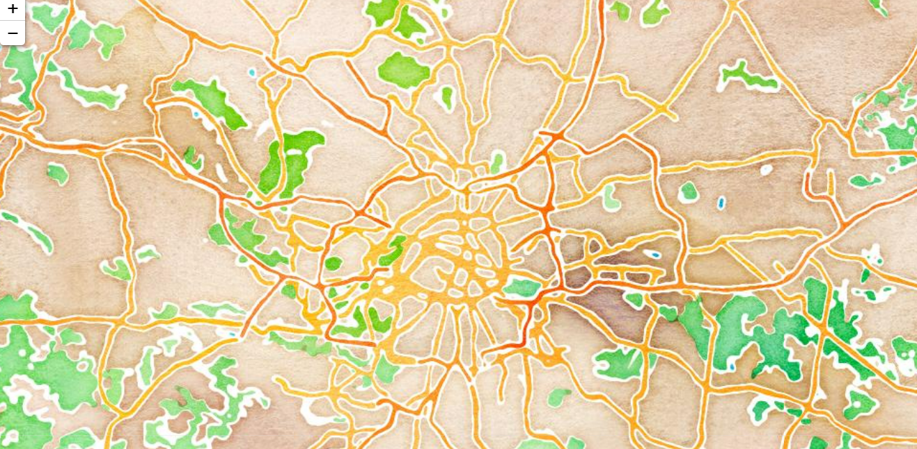
Layers and Tiles in Folium
Lets re-visit Paris with ‘Stamen Water Color’ tiles
onerMap = folium.Map(location=[48.85, 2.35], tiles="Stamen Water Color", zoom_start=10)
onerMap

Slide 43
Plotting Markers on the Map
Markers are the items used for marking a location on a map.
For example, when you use Google Maps for navigation, your location is marked by a marker and your destination is marked by another marker.
Markers are among the most important and helpful things on a map.
Folium gives a folium.Marker() class for plotting markers on a map.

Slide 44
Marking Cukurova University on The map
import folium
from branca.element import Figure
fig=Figure(width=550,height=350)
m=folium.Map(location=[37.061315, 35.350779])
fig.add_child(m)
folium.Marker(location=[37.061315, 35.350779],popup=‘Cukurova University',tooltip='Click here to see Popup').add_to(m)
m

Slide 45
Foilum Tutorial:
https://www.analyticsvidhya.com/blog/2020/06/guide-geospatial-analysis-folium-python/

Slide 46
Summary
Bubble charts
Heat Maps
Radar Charts
Area Charts
Interactive Charts
Folium Library
Maps

Slide 47
References
Bubble Charts in Python
https://towardsdev.com/bubble-charts-in-python-8ed485e5bc96
https://towardsdatascience.com/bubble-charts-why-how-f96d2c86d167#:~:text=Why%3A%20bubble%20charts%20are%20used,or%20to%20compare%20categorical%20variables.

Slide 48
Interactive Plots

Slide 49
Interactive Plots
There are various libraries in Python that you can use for interactive data visualization
We will use plotly
Plotly produces interactive graphs, can be embedded on websites, and provides a wide variety of complex plotting options. The graphs and plots are robust and a wide variety of people can use them. The visuals are of high quality and easy to read and interpret

Slide 50
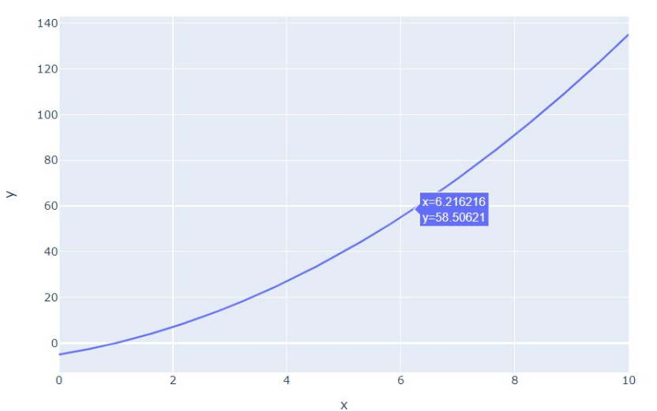
Interactive Plots
Drawing a random line
import numpy as np
import pandas as pd
import plotly.express as px
x = np.linspace(0, 10, 1000)
y= 3*x**2 - 2*x**2 + 4*x- 5
fig = px.line(x=x ,y =y,labels={'x':'x', 'y':'y'})
fig.show()

Slide 51
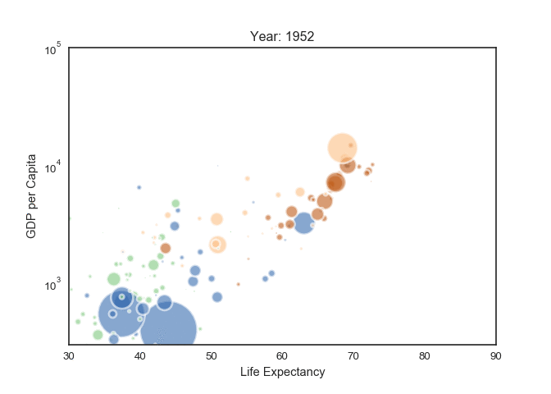
Interactive Plots
Interactive bubble chart
https://www.python-graph-gallery.com/341-python-gapminder-animation

Slide 52
Sun burst Charts

Slide 53
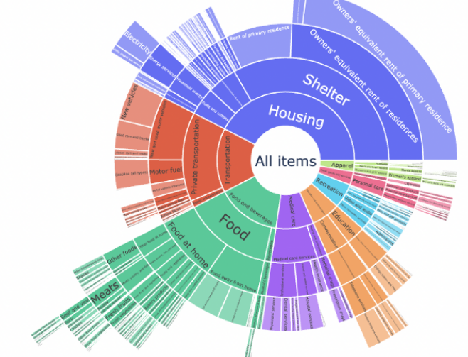
Sun burst Charts
an advanced type of pie-chart in which the different levels of data are represented as concentric circles.
Use to view Hierarchical data

Slide 54
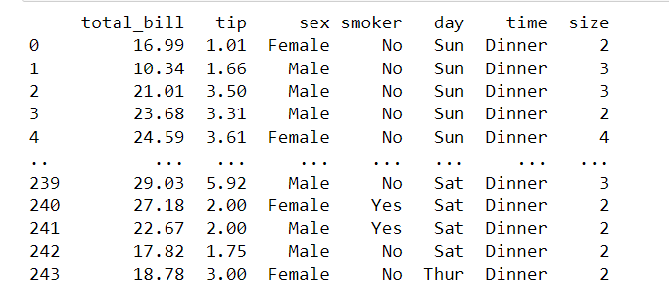
Dataset
Suppose we have this data about when people are coming to restaurant? Who is paying the bill? Etc.

Slide 55
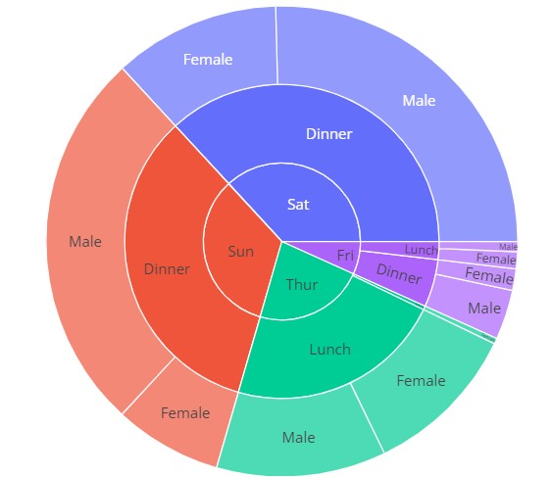
Sun burst Charts
Lets make a sunburst chart for this:
Sunburst plots visualize hierarchical data spanning outwards radially from root to leaves.
import plotly.express as px
df = px.data.tips()
fig = px.sunburst(df, path=['day', 'time', 'sex'], values='total_bill')
fig.show()

Slide 56
Question?(m)
Any observation from this sunburst chart?

Slide 57
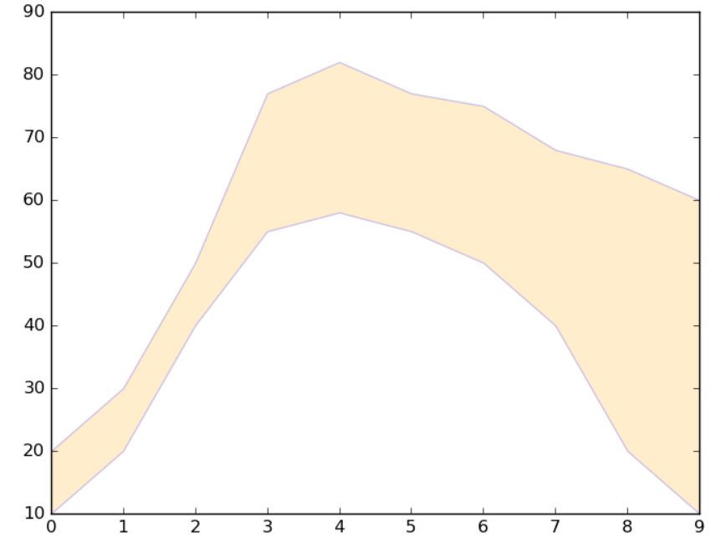
Shaded Region between two lines
Soometime we want to show the area between two lines
We can make some chart like following

Slide 58
Observations
People coming for dinner on Saturday and Sunday
People coming for lunch on Thursday
On Friday they are coming for both lunch and dinner
on Saturday/Sunday, most of the time dinner bill or tip is paid by male

Slide 59
Shaded Region between two lines

Slide 60
Shaded Region between two lines
plt.fill_between(),
Data
facecolor="orange", # The fill color
color='blue', # The outline color
alpha=0.2 # Transparency of the fill

Slide 61
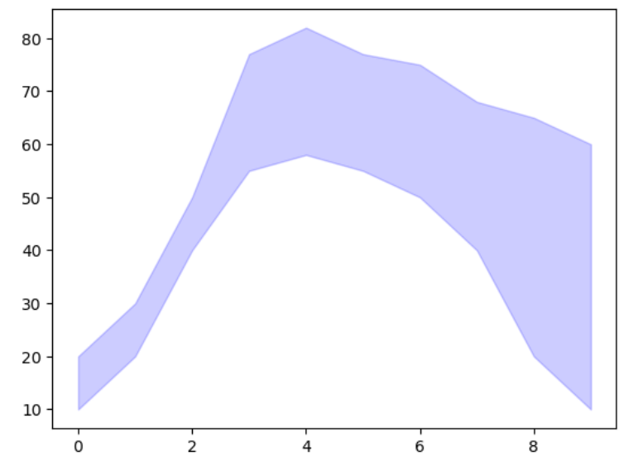
Shaded Region between two lines
import matplotlib.pyplot as plt
# Data
x = [0,1,2,3,4,5,6,7,8,9]
y1 = [10,20,40,55,58,55,50,40,20,10]
y2 = [20,30,50,77,82,77,75,68,65,60]
# Shade the area between y1 and y2
plt.fill_between(x, y1, y2,
color='blue', # The fill color
alpha=0.2) # Transparency of the fill
# Show the plot
plt.show()

Slide 62
Sparkline Excel

Slide 63
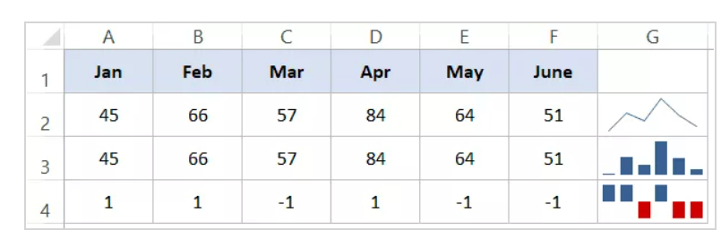
What are Sparklines?
Sparklines are tiny charts that reside in a cell in Excel.
These charts are used to show a trend over time or the variation in the dataset.
You can use these sparklines to make your bland data look better by adding this layer of visual analysis.
https://trumpexcel.com/sparklines/

Slide 64
Types of Sparklines in Excel
In Excel, there are three types of sparklines:
Line
Column
Win-loss

Slide 65
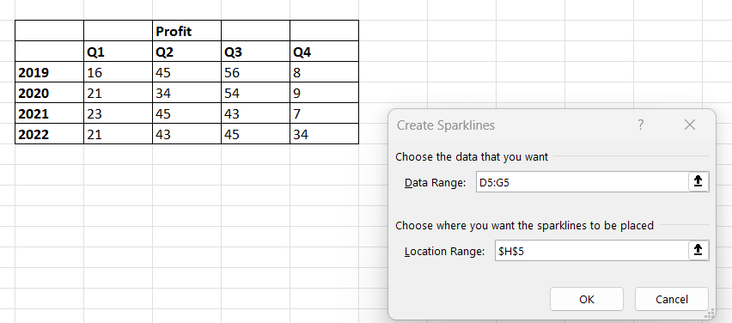
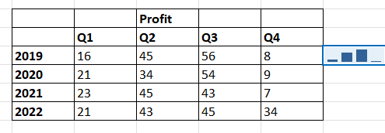
Sparklines in Excel
Click on the cell where you want the sparkline to appear
Go to insert - > sparkline
Choose the desired cell that form the data for sparkline
Press ok

Slide 66
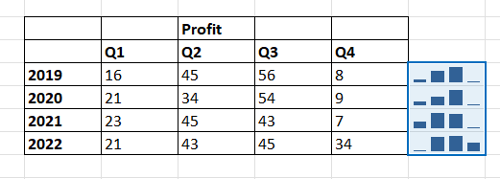
Sparklines in Excel
Drag and drop to copy it to all the cell

Slide 67
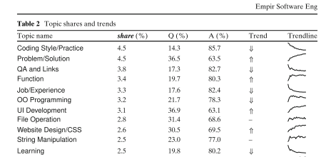
Case study
Case study: paper 1: What are developers talking about? An analysis of topics and trends in Stack Overflow

